Slide 1
ABSORPTION LAW
A)X+XY=X
B)X(X+Y)=X

Slide 2
Absorption Law
A)X+XY=X
Proof:A)X+XY=X
LHS=X+XY
=X(1+Y)
=X. 1
=X
=RHS

Slide 3
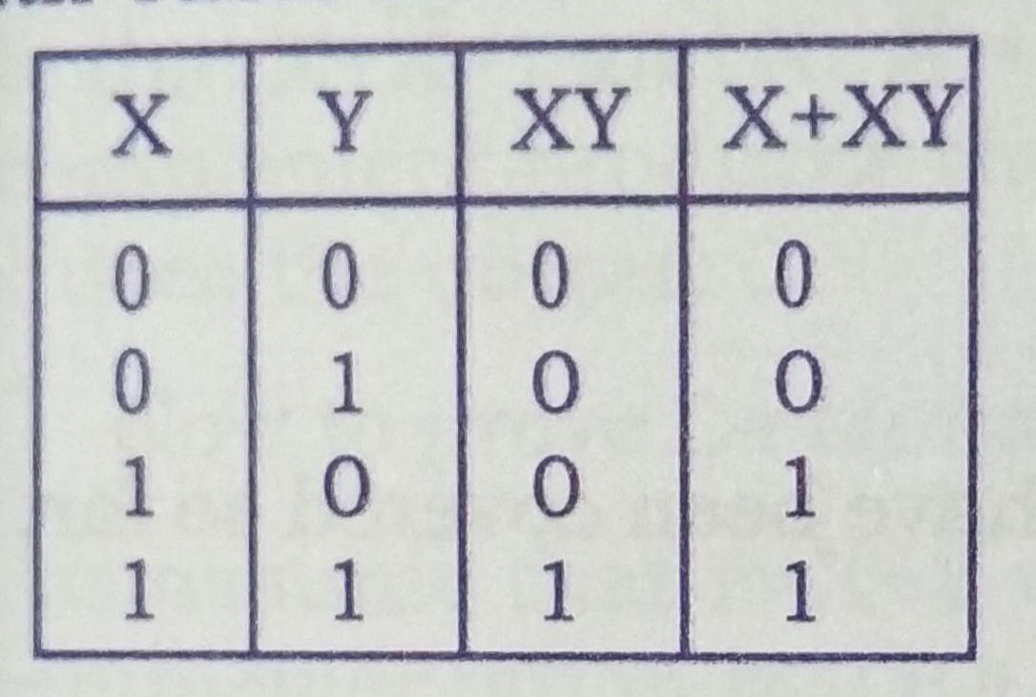
X+XY=X

Slide 4
ABSORPTION LAW
B)X(X+Y)=X
LHS=X(X+Y)
=X. X+XY
=X+XY
=X(1+Y)
=X. 1
=X
=RHS

Slide 5
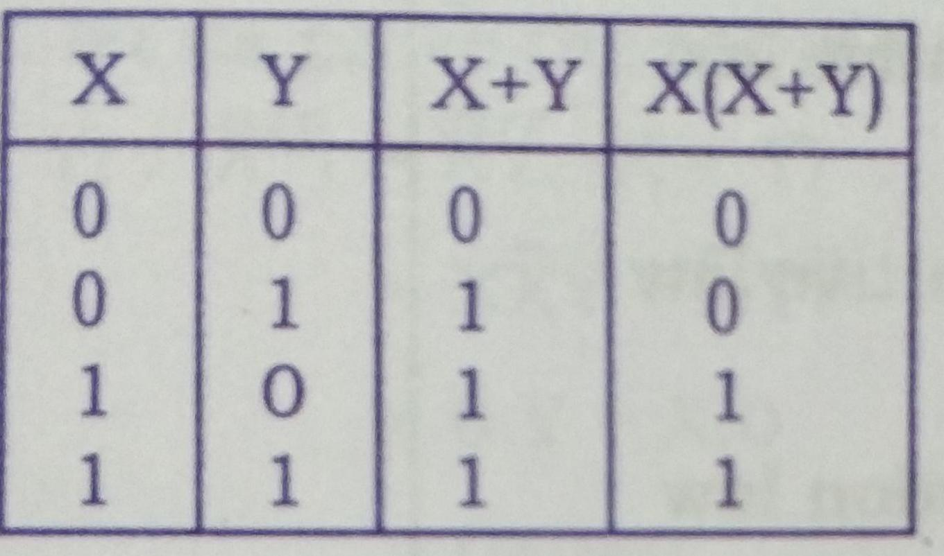
X(X+Y)=X

Slide 6
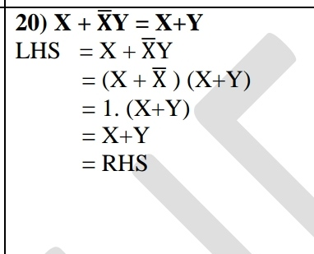
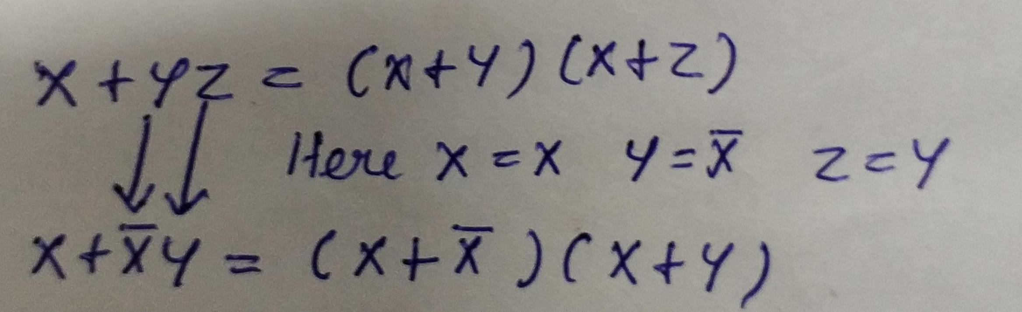
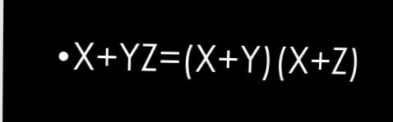
Third distributive law

